Slide 1
Model-based Reinforcement Learning

Slide 2
Objectives
Model-based Reinforcement Learning
Dyna-Q
Learned transition model
Trajectory sampling
Sampling Comparison

Slide 3
Model-based Reinforcement Learning
Planning algorithms
dynamic programming: value iteration and policy iteration
require a model of the environment
Learning algorithms
model-free methods: doesn’t require MDP internals
Not requiring the MDP in advance is a of crucial importance
often the MDP is challenging or even impossible to obtain
imagine to represent the game of Go with its 10.170 possible states
StarCraft II game with 101.685 states
However, what if we learn a model as we interact with the environment?
we explore the environment (like model-free methods), but we learn a model of the environment from these interactions
by exploiting the learned model (like dynamic programming), agents often require fewer experience to learn optimal policies

Slide 4
Dyna-Q (1)
Interleave
a model-free method (Q-learning)
use experiences sampled from the environment
and a planning method (Value Iteration)
use experiences sampled from the learned model
We keep track of the transition and reward functions as three-dimensional tensors
indexed by state (s), action (a), and next state (s’)
keeps count of the number of times we seen the tuple (𝑠,𝑎,𝑠′)
indicating how many times we arrived at state 𝑠′ from state 𝑠 when selecting action 𝑎
holds the average reward we received on the tuple (𝑠,𝑎,𝑠′)
indicating the expected reward when we select action 𝑎 on state 𝑠 and transition to state 𝑠′

Slide 5
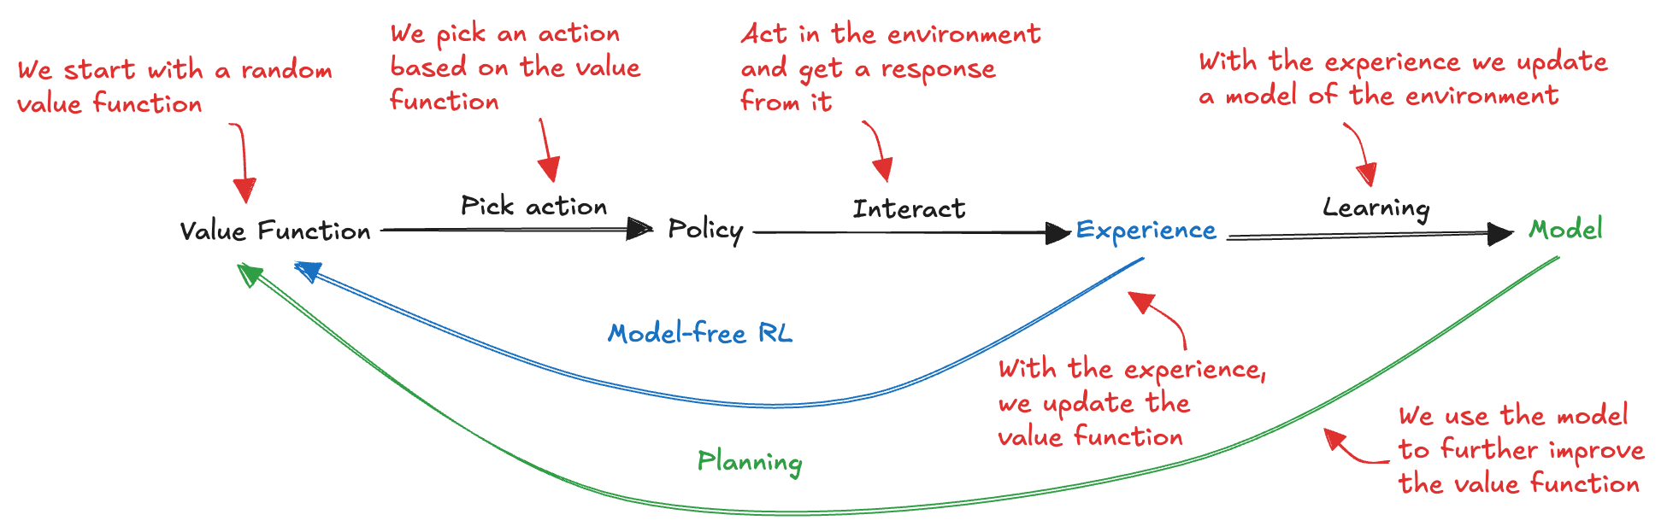
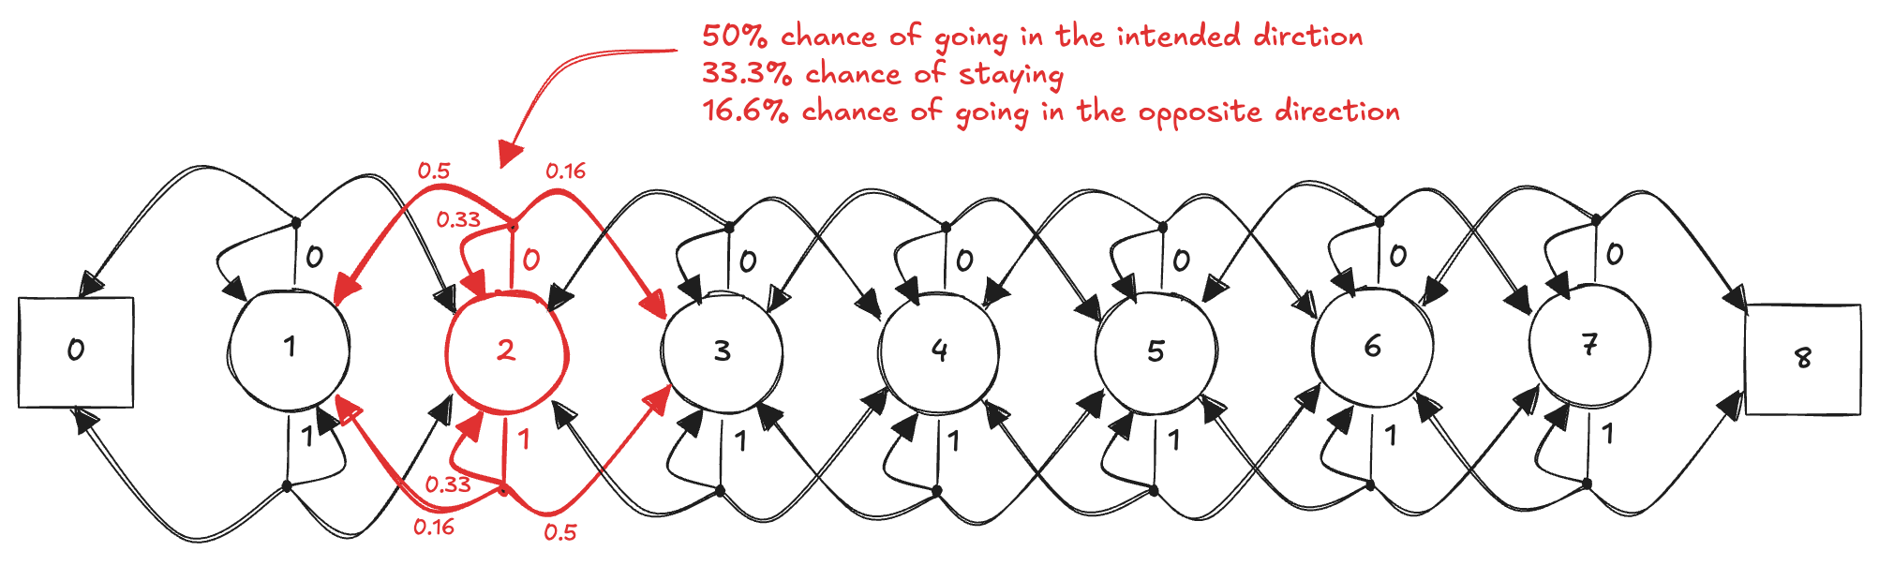
Dyna-Q (2)
We can use again the Slippery Walk environment

Slide 6

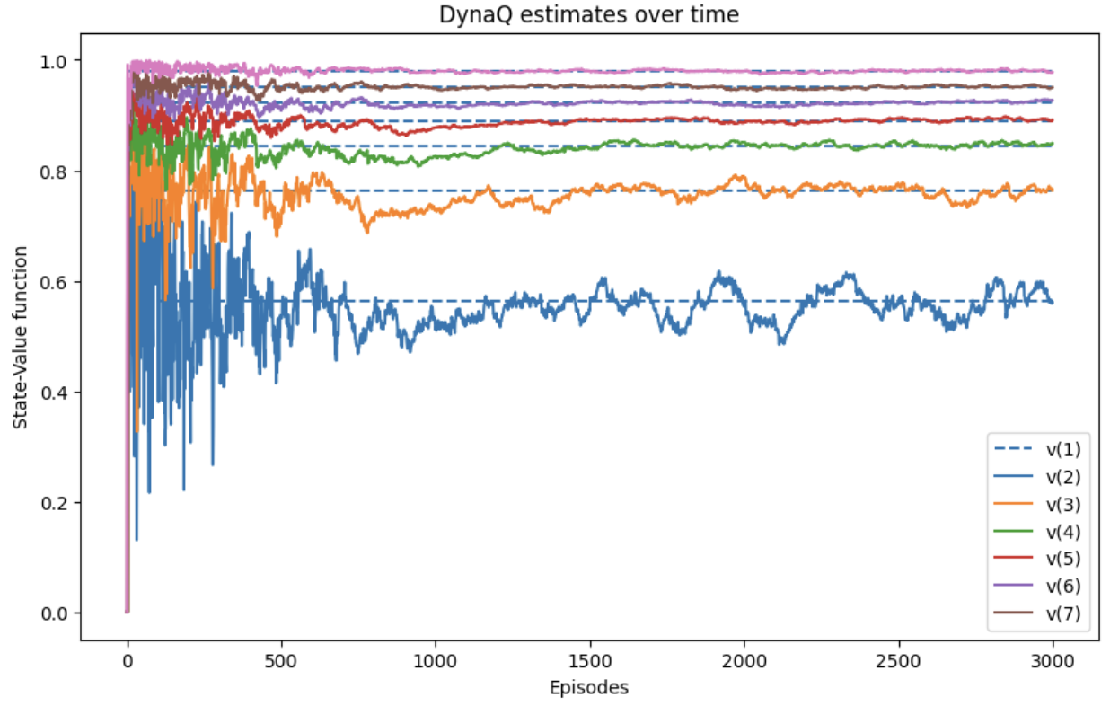
Dyna-Q (3)

Slide 7
Dyna-Q (4)
Dyna-Q can learn faster than model-free methods
it can learn from both real and simulated experiences
Important in applications where interacting with the environment is expensive or time-consuming
e.g. robotics
Performance is dependent on the accuracy of its learned model
if the model is inaccurate, the agent may make poor decisions
problematic in changing environments, where the model needs to be constantly updated. Moreover, planning can be computationally expensive
We can check the model learned by DynaQ

Slide 8

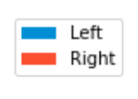
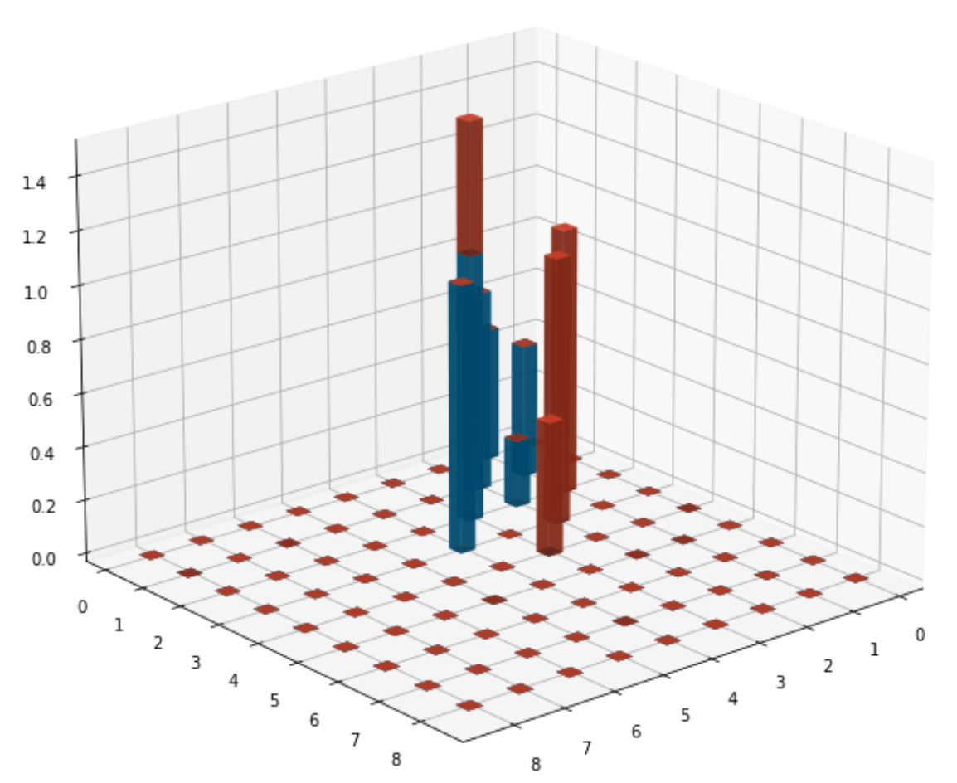
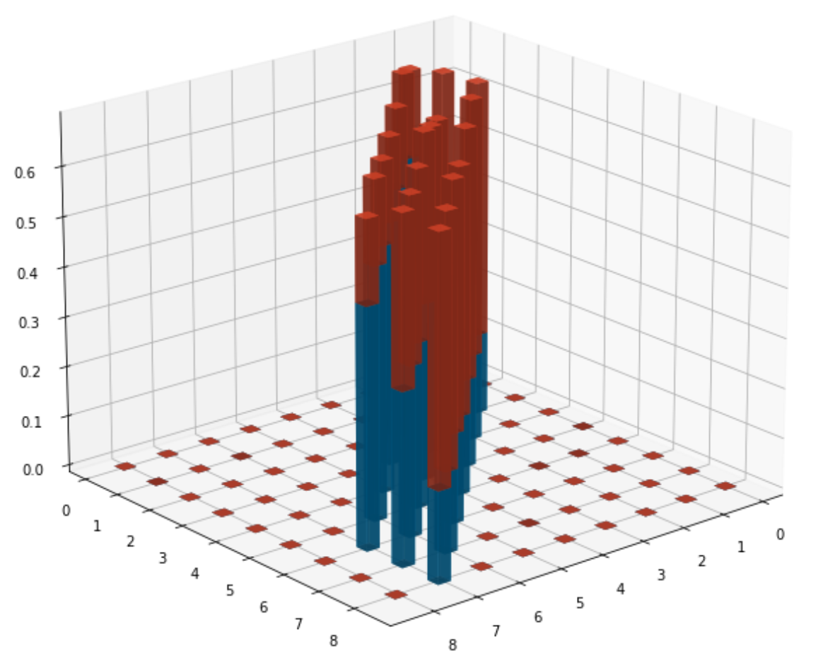



Learned transition model
We can try to understand the learned transition model
bar heights are the transition probabilities
At the end, the probabilities are good enough and describe the MDP correctly
this is a simple environment, so the agent can gather enough experience quickly

Slide 9
Trajectory sampling (1)
Dyna-Q in planning phase samples from the state-action pairs that have been visited
we don’t waste time with state-action pairs about which the model has no information
however, from those pairs, we sample a uniformly at random
We can be more effective if we
use a state that we expect to encounter during the current episode
planning for the immediate future is a smarter approach
sample actions from
the same behavioural policy (on policy)
or from a greedy policy with respect to the current estimates (off policy)

Slide 10
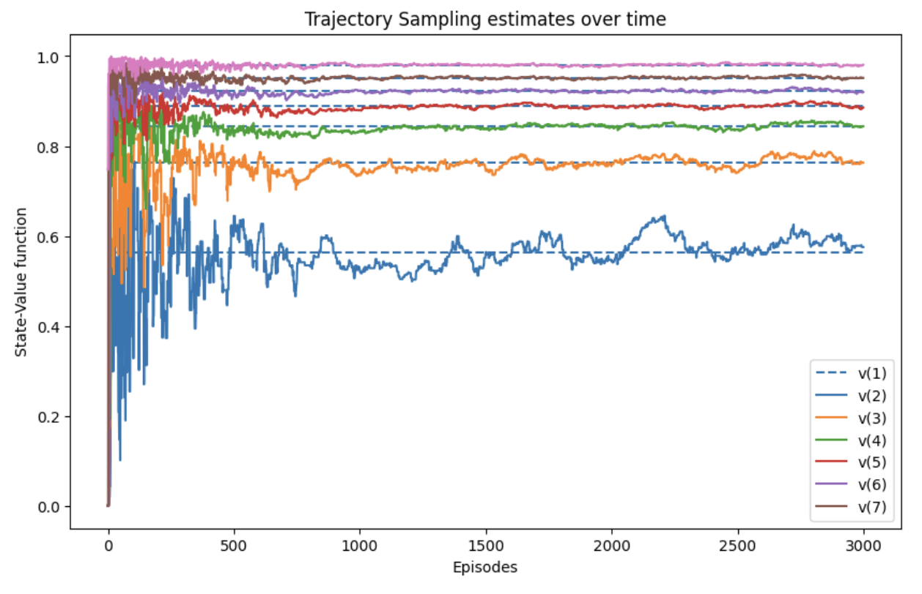
Trajectory sampling (2)

Slide 11
Sampling Comparison (1)
Dyan-Q
the uniform sampling encourages more exploration, potentially leading to the discovery of novel strategies or shortcuts
however, this can also make it less efficient in exploiting already known rewarding paths.
Trajectory Sampling
the focus on the current policy, prioritizes exploitation, can lead to faster convergence to a good (though not necessarily optimal) policy.
the focused on frequently encountered states, is less likely to be affected by inaccuracies in less visited parts of the model
We can compare the differences in sampling the model of DynaQ and Trajectory sampling:
plot the states that were sampled by the planning phase of the two algorithms
and the actions selected in those states

Slide 12
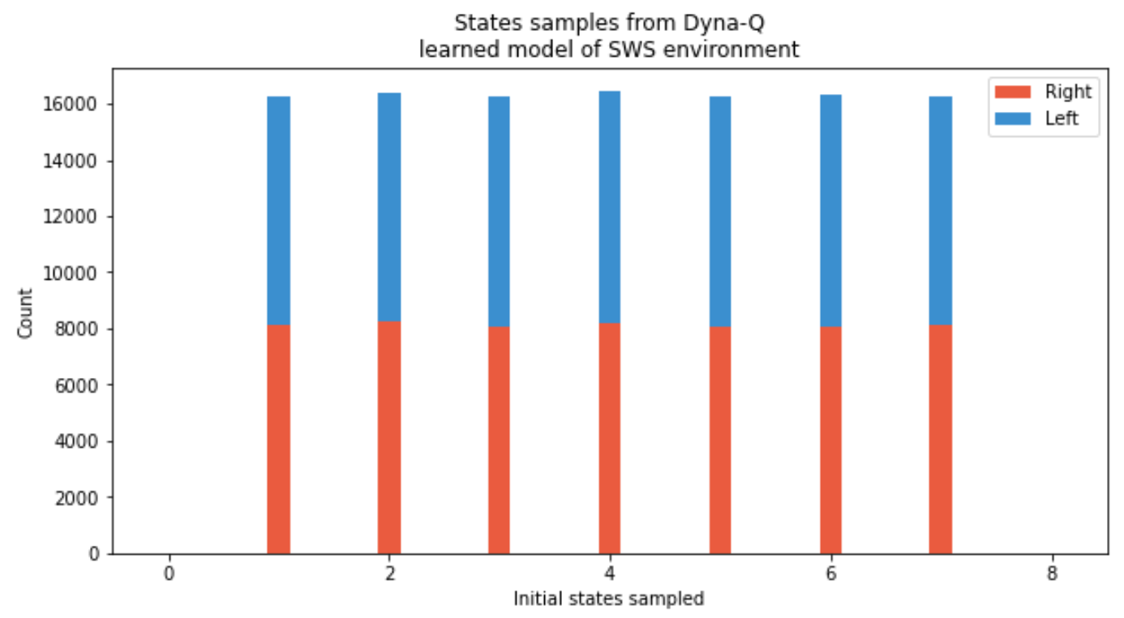
Sampling Comparison (2)
Dyna-Q samples uniformly at random states and actions taken

Slide 13
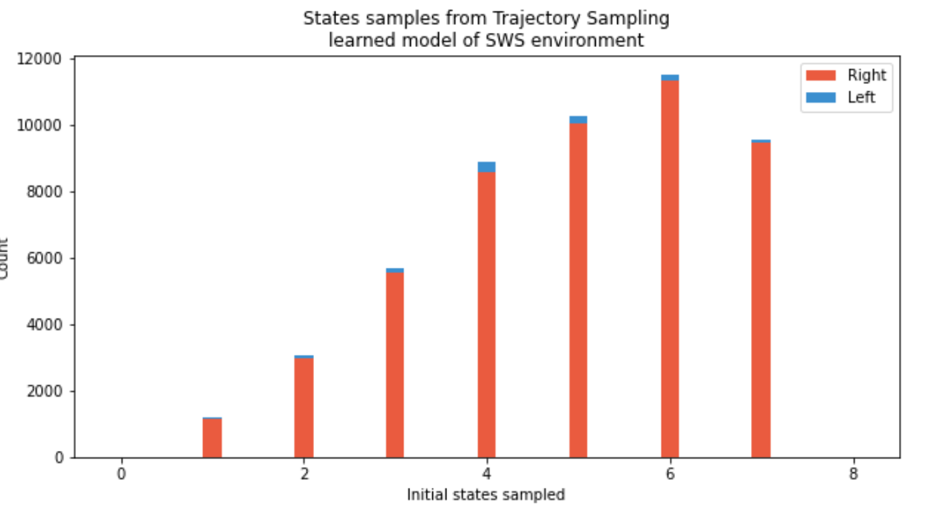
Sampling Comparison (3)
Trajectory sampling samples the model to improve greedy action selection
states sampled are skewed toward the goal state
right action is sampled far more than the left action across the boar

